Slide 1
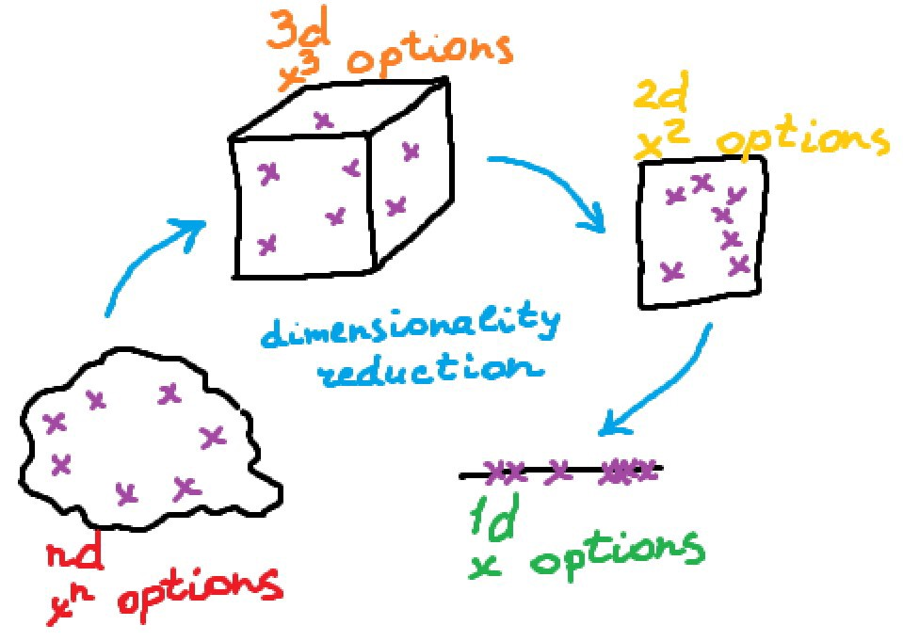
Dimension Reduction and Feature Selection

Slide 2
Dimensionality
Dimensionality refers to the number of inputs or features for a dataset.

Slide 3
Dimensionality Reduction
Dimensionality reduction simply refers to the process of reducing the number of attributes in a dataset while keeping as much of the variation in the original dataset as possible
Note: It is a data preprocessing step meaning that we perform dimensionality reduction before training the model

Slide 4

Why don’t we give all the features to the ML algorithm and let it decide which feature is important?

Slide 5
Importance of Dimensionality Reduction
A lower number of dimensions in data means less training time and less computational resources and increases the overall performance of machine learning algorithms.
Dimensionality reduction avoids the problem of overfitting.
Dimensionality reduction is extremely useful for data visualization.
Dimensionality reduction takes care of multicollinearity.
Dimensionality reduction removes noise in the data.
Notes:
1. Machine learning problems that involve many features make training extremely slow
2. When there are many features in the data, the models become more complex and tend to overfit on the training data.
3. When we reduce the dimensionality of higher dimensional data into two or three components, then the data can easily be plotted on a 2D or 3D plot.
4. In regression, multicollinearity occurs when an independent variable is highly correlated with one or more of the other independent variables. Dimensionality reduction takes advantage of this and combines those highly correlated variables into a set of uncorrelated variables. This will address the problem of multicollinearity.
5. . By keeping only the most important features and removing the redundant features, dimensionality reduction removes noise in the data. This will improve the model accuracy.

Slide 6
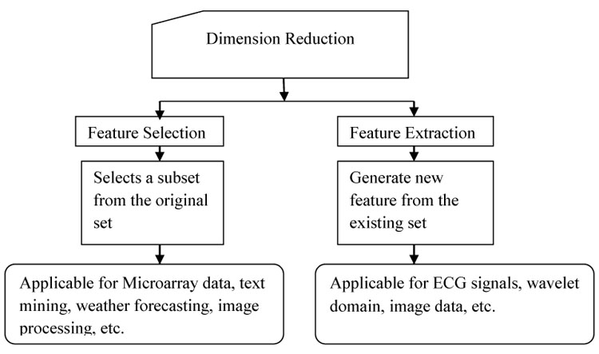
Dimensionality Reduction Techniques
Source: https://benthamopen.com/FULLTEXT/TOBIOIJ-11-117/FIGURE/F1/

Slide 7
Feature Selection
Feature Selection is the process of reducing the number of input variables to find the best set of features that allows one to build useful models.
Features Selection can be divided into three major categories;
Filter-based
Wrapper-based
Embedded

Slide 8
Filter-based Feature Selection
In a Filter-based feature selection we specify some metric and based on that filter features.
An example of such a metric could be correlation/chi-square.

Slide 9
Embedded Feature Selection
Embedded methods use algorithms that have built-in feature selection methods.
For instance, Lasso and Random Forest have their own feature selection methods.

Slide 10
Wrapper-based Feature Selection
Wrapper methods consider the selection of a set of features as a search problem.
Example: Recursive Feature Elimination

Slide 11
Feature Extraction
Feature Extraction is the process of transforming raw data into numerical features that can be processed while preserving the information in the original data set.
It aims to reduce the number of features in a dataset by creating new features from the existing ones (and then discarding the original features).

Slide 12
5 minutes video to elaborate on the two techniques
Link to short explanation on Feature Selection and Extraction

Slide 13
Next : Practical Session

